Slide 1
Soft tissue injuries of extremity
Saranga Wimalarathne

Slide 2
introduction
In multi-trauma patients – identify the life threatening conditions.
Primary survey and initial resuscitation.
Then identify the soft tissue injuries of extremities.
But attention should be given to control of bleeding in extremities.

Slide 3
Evaluation of patient
History
Mechanism of injury.
Environment.
Predisposing factors.
Examination (head to toe examination)
Inspection- wounds, colour, swelling, bruising,
Palpation- tenderness, pulse, capillary filling, warmth, sensation.

Slide 4
Identify the injuries
Skin and subcutaneous tissues only
Vascular injury- need early attention
Nerve damage-
Musculosketetal damage- splinting

Slide 5
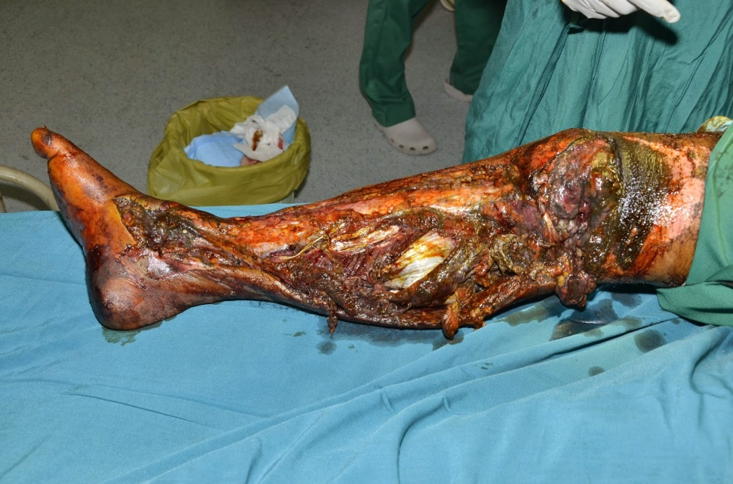
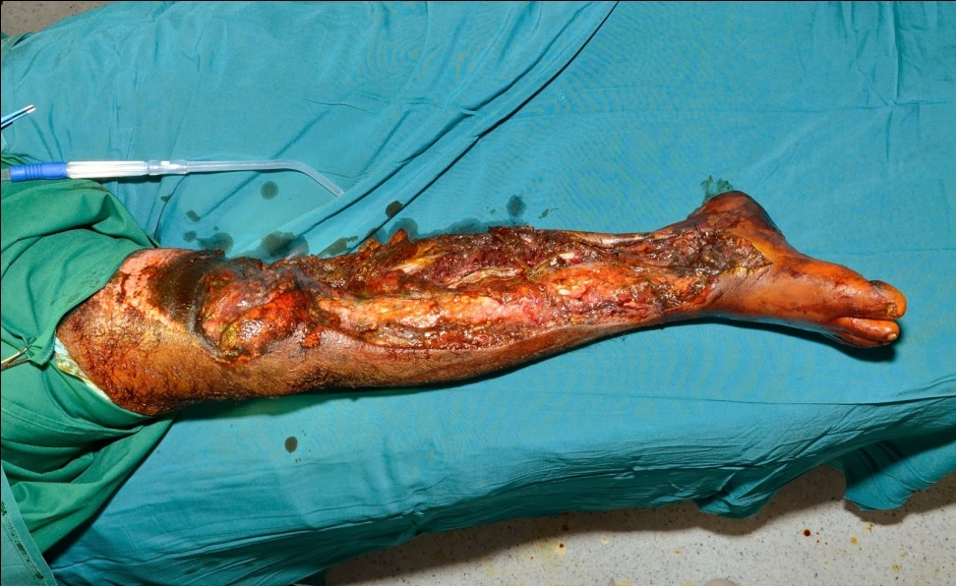

Slide 6
Crush injury
Part of body is being squeezed/compressed between two high force or pressure systems.
Causes extensive lacerations, bruising, compartment syndrome, crush syndrome, fractures, extensive tissue destruction and devitalisation.

Slide 7
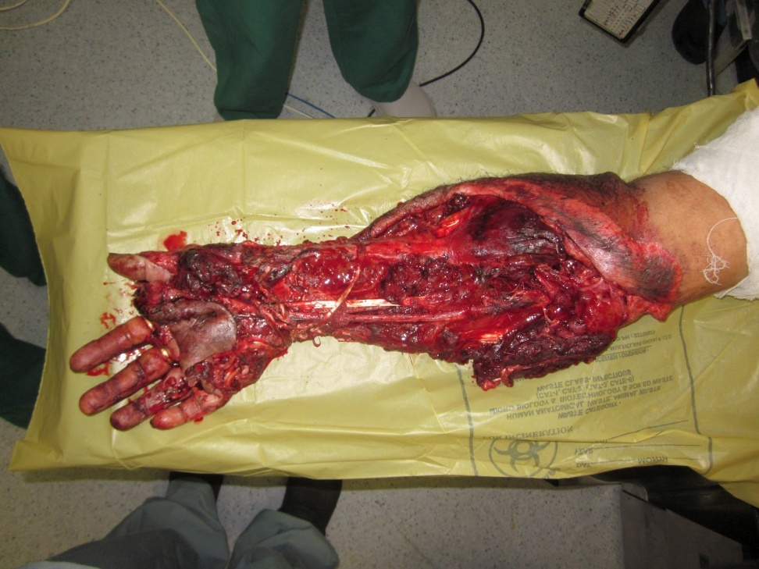
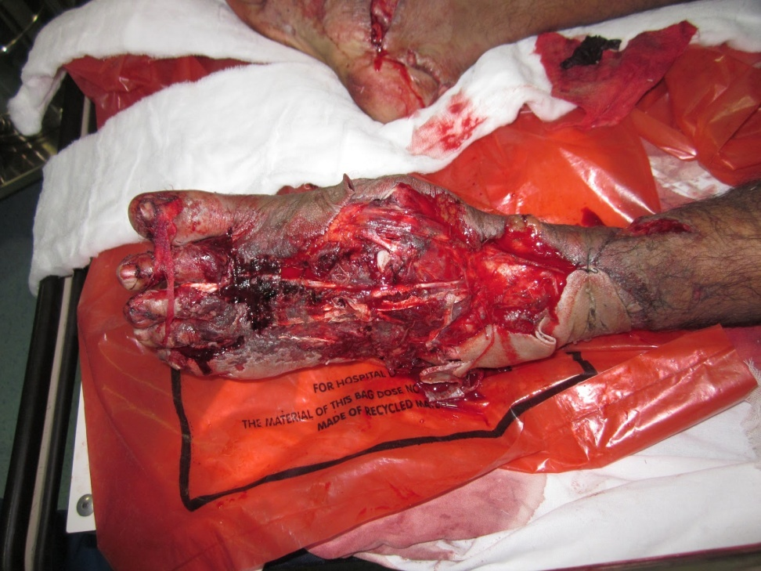

Slide 8
Crush syndrome
Due to crushing of muscles causing extravasation of blood and release of myoglobin into circulation leading to acute tubular necrosis and acute renal failure.
Causes- RTA. earthquakes, mining and industrial accidents, air crash.
Increased tension in muscle compartment causes ischemic injury.
Urine becomes discolored, UOP reduces, patient becomes restless and delirious with onset of ureamia.

Slide 9
Effects of crush syndrome
Renal failure.
Toxaemia.
Septicaemia.
Disability with extensive tissue loss.
Gas gangrene.

Slide 10
Treatment
Initial aggressive volume loading.
Fasciotomy and proper wound debridement.
Mannitol to improve renal funtion.
Alkalisation of urine by sodium citrate or sodium bicarbonate to increase solubility of acid heamatin and to promote its excretion.
Haemodyalisis.
Other measures- catheterization, oxygen, antibiotics, correct hyperkalaemia.

Slide 11
Compartment syndrome
Due to increased intra-compartmental pressure within a limited space area.
Causes- tight dressings plaster cast, fractures, edema, ischaemic injury, heamatoma, burns, snake bite,
Affects- circulation, nerves, muscles, (muscle ischaemia more than 4 hours causes muscle death)
Common in legs, forearms.

Slide 12
Clinical features
Progressive persistent severe pain aggravated by muscle stretching is the diagnostic sign.
Pallor
Pulselessness
Pain
Parasthesia.
Diffuse swelling
Cold limb.

Slide 13
Complications
Infection, septicaemia and abscess formation.
Renal failure.
Gangrene of limb.
Chronic ischaemic contracture.
Disabled limb, Volkmanns ischaemic contracture.

Slide 14
Treatment
Early identification.
Remove, bivalve the plaster or cast as soon as possible.
Compartment pressure more than 30mmhg is a indication for fasciotomy.
Adequate incision involving skin, fat, deep fascia. Underneath muscle should bulges out.
Antibiotics.
Catheterization and UOP monitoring.
Hyperbaric oxygen.
Mannitol.

Slide 15
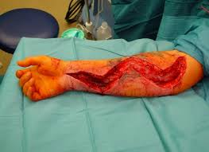
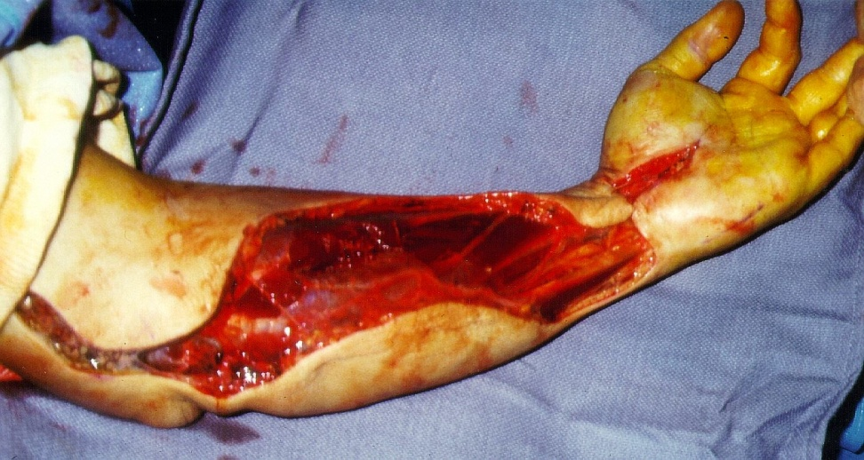

Slide 16

Thank you

